Slide 1
RFIDefense
Group 11: Justin Farkas, Fiacre Indagiye Siboman, Young Jung, Jake Mecimore, Charles Valdez
Notes:
What's the Problem
What's the solution
Who are the users
How it will get done

Slide 2

What's The Problem
As the times change so does technology.
But the one thing that stays constant is the need for convenience
Creating secure hub that will make coming home or entering a room an experience of true convenience

Slide 3
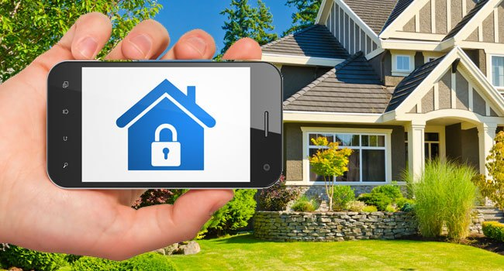
Project Description
The purpose of our project is to create a user-friendly home monitoring system that will allow users to monitor and secure their household belonging even while they are away from home.

Slide 4
System Features
RFID
Used as a key to unlock doors and even electronic devices
User Reporting
The ability to track system usage by user and visualize that data
Mobile Application
Users will be able to control the system remotely

Slide 5

Users
Parents
Senior Adults
Property Renters
Techies
Anyone

